Slide 1
Digital PSAT
PSAT /NMSQT (Grades 10/11)
Fall 2025

Slide 2
Who to Test
The state is paying for all 10th graders to take the PSAT/NMSQT
11th graders who want to take the PSAT/NMSQT for National Merit qualification will need to pay for their own test.
  Schools will need to collect money prior to and then print/pay remittance to College Board
Cost for 2025 is $18.00

Slide 3
Dates
PSAT/NMSQT is a fully digital exam
Window is open 10/1/2025 – 10/31/2025
Schools may test any day within the window and hold make up sessions during the window

Slide 4
Changes for Fall 2025
Changes to the Bluebook™ Experience
Time Paused on Exit
  The test timer will pause for a limited time if students exit the Bluebook app, giving them a chance to recover from technical issues.
New Calculator Option
  All students taking SAT and PSAT-related assessments can now toggle between scientific and graphing options in the embedded Desmos calculator. Students can switch options at any point in the exam. Sign in to Bluebook today to practice with both options.
  You may bring your own approved, hand-held calculator for testing. If you choose to bring your own, make sure to review our prohibited calculator list as we've recently updated our calculator policy.

Slide 5
Changes, Pt 2
Changes to Accommodations
Reminder from Spring 2025
  Once standard time elapses, students with extended time accommodations now have the option to click Next and continue or end their test. They'll see a confirmation screen that warns them they won't be able to return to the previous section once they leave it.
Screen Reader Update
  Students approved to use a screen reader will no longer be automatically approved for extended time. They will need a separate approval for this accommodation.
Nutrition Break Policy
  Students approved for extended breaks or breaks as needed will no longer receive a nutrition break.
Text To Speech Functionality
  Students will have the option to click Pause to resume the voiceover from where they left off. They may also click Stop to start the voiceover again from the beginning.
Accommodations and Supports Dashboard
  Students are now able to track their requests for accommodations, download decision letters, and view their accommodations history online.

Slide 6
Changes for Testing Staff
Test Day Toolkit Proctor Preview
  We heard from staff the desire to be able to see things and walk through Test Day Toolkit before test day, so we are excited to announce our new Proctor Preview! After receiving access to Test Day Toolkit, staff will be able to walk through all the proctoring screens like they would on test day.
Shortened Readiness Timeline
  Based on your feedback, we’ve updated the in-school readiness timeline from five weeks to three weeks to reflect the actual time it takes to prepare for an administration. See these updates reflected on the In-School Testing Checklist and in the Test Coordinator Manual.
Modifications to Staff Training Experience
  We've refreshed the look of the training system with simplified navigation and a cleaner layout to help you quickly find and complete your training. Our training modules now have more options to customize your training by role, including allowing users to select multiple roles if necessary. Test coordinators will also be able to see which of their staff members have completed training and note whether any staff members have been trained on site.
New Customer Service Hours
  You can now reach College Board at 866-630-9305 from 7:30 a.m. to 8 p.m. ET.
Test Security Update for Coordinators
  If a student is caught taking a picture of test content, the test coordinator will be responsible for taking a picture of the content on that student's phone and storing it safely for test security.

Slide 7
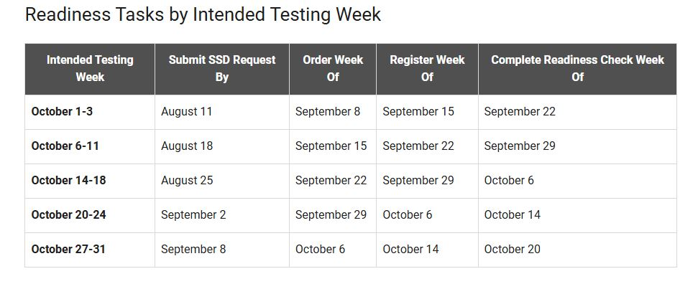
PSAT Deadlines

Slide 8
Requesting Accommodations
SSD Online
Collect all appropriate paperwork
  IEP/504/ELL
  Records (medical/psychoeducational)
Sign in to create request
Answer a series of questions
  Student demographic
  Disability
  Requested accommodations
  Current school plant
Review and verify your request
Submit required documentation
ELL Supports - ELL

Slide 9
PSAT/NMSQT Organization
The digital SAT Suite of Assessments uses multistage adaptive testing.
Each test section (Reading and Writing, Math) is divided into two equal-length, separately timed parts, called modules.
Students answer a set of questions in the first module before moving on to the next.
The questions that students are given in the second module depend on how they performed on the first module.
Section | Time Allotted (min.) | Number of Questions
Reading and Writing | 64 | 54
Math | 70 | 44

Slide 10
Test Preparation - Coordinator
Get Access to SAT Suite Ordering and Registration (SSOR) - Contact Test Administration (TA) Support
testadminsupport@collegeboard.org
866-502-6384
Order tests for your administration – total # of enrolled + 10% extra
In-School Testing Checklist

Slide 11
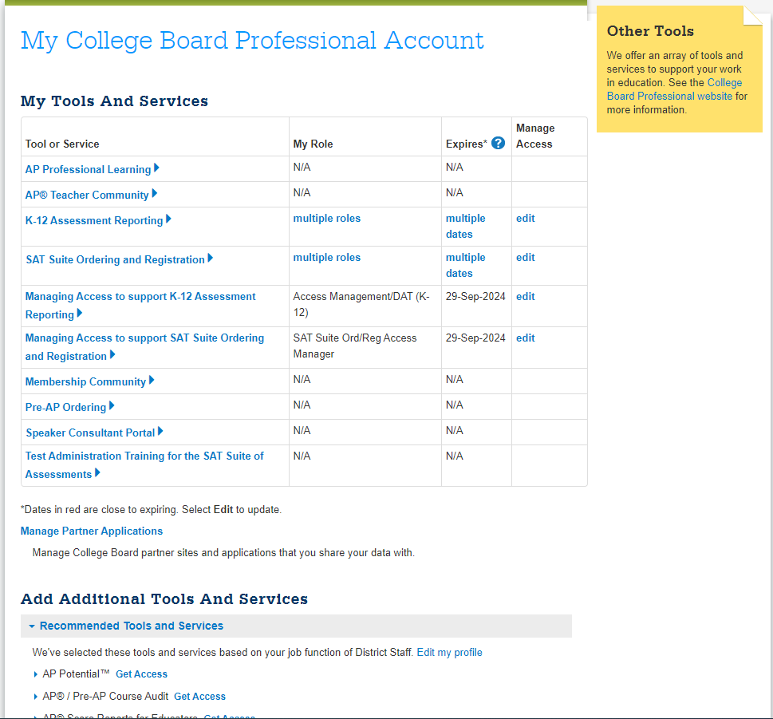
Built-in PSAT training for each member of PSAT staff
Training is REQUIRED by College Board
You are able to track staff completion on your Bluebook
dashboard

Slide 12
Test Preparation - Coordinator
All staff that will be involved with administering the PSAT/NMSQT must have a College Board professional account
www.Collegeboard.org
You will manage access from within your CB account under “Dashboard”, “General”, “Managing Access to Support Test Day Toolkit”
You will grant full access in Test Day ToolKit one day prior to your scheduled test day to all test day staff to allow them to accomplish test day tasks

Slide 13
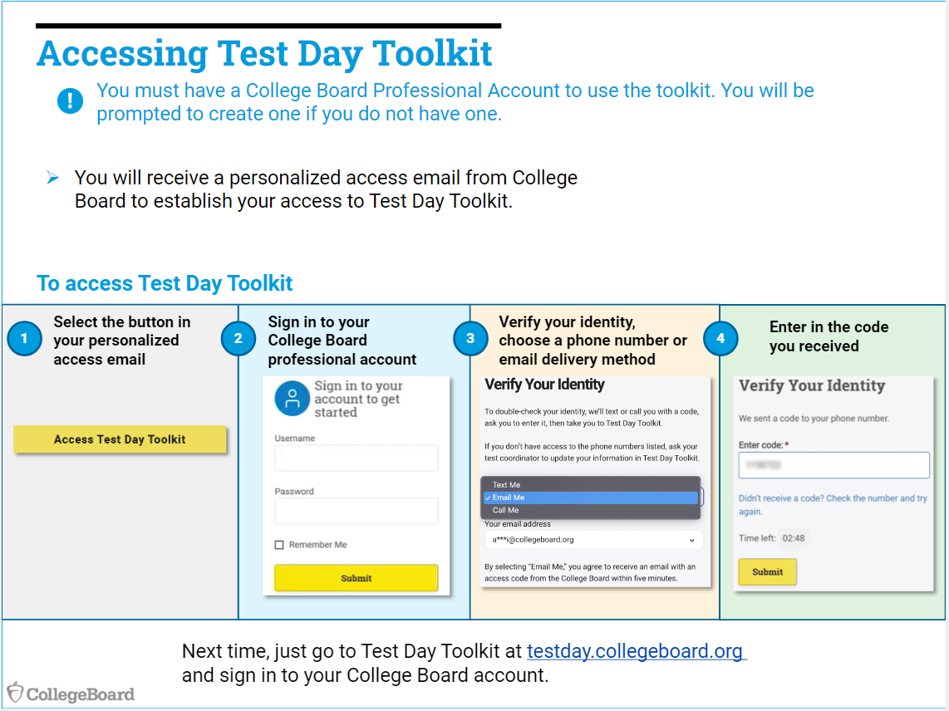

Slide 14
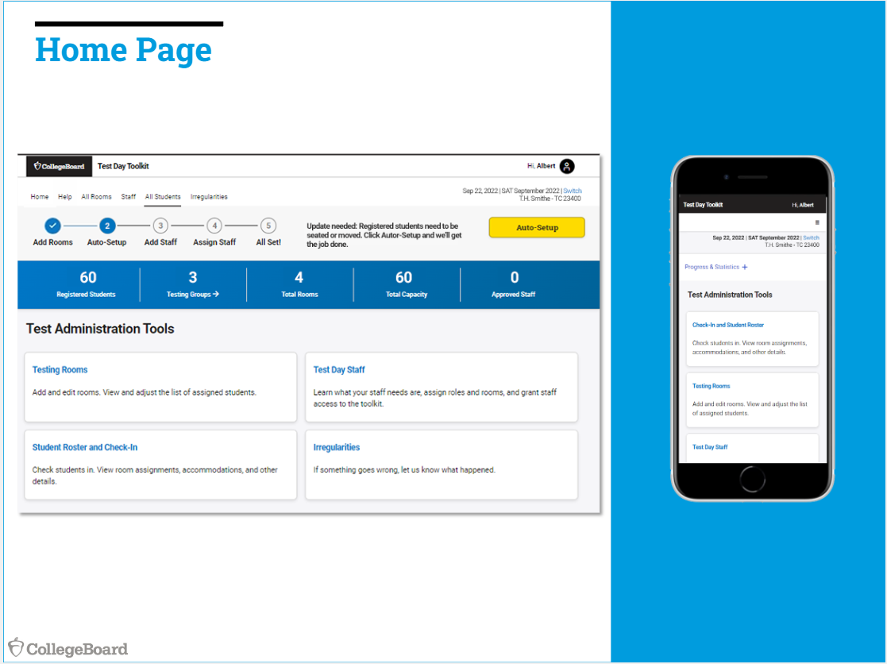

Slide 15
Training
All test day staff are required to complete the College Board required training.
Modules are available about 4–6 weeks before the opening of the testing window.
Test coordinators receive an email when training is available and should forward the email to test day staff.
You'll need a College Board professional account to sign in; if you don’t have one, you can create one. You'll also use this same account to log in to Test Day Toolkit.
Staff with experience delivering tests in the digital SAT Suite can condense the course or may be able to test out of topics.
Coordinators will be able to see staff’s training completion status by navigating to the Training Status Dashboard on their training launch page.

Slide 16
Training
Training is required for the following staff:
  School test coordinator (55-75 Mins) Test Coordinator
  SSD coordinator SSD Coordinator
  Proctor (30-45 mins) Proctor
  Hall and room monitor (20-45 mins) Hall & Room monitor
  Technology Coordinator (25-35 mins) Technology Coordinator
  Technology monitor (25-35 mins) Technology monitor
The training topics will vary by your test day role, but some common topics include:
  Policies and procedures for digital testing
  Using Test Day Toolkit
  Bluebook™ digital testing application for students
  Testing students with accommodations or English learner supports
  Device requirements for students and staff

Slide 17
Student Registration
Registration can only take place after an order has been placed
Student data is uploaded into SSOR by the Data Coordinator (set as Scott Dodson by ALL schools)
  This creates an SSOR Registration Roster
Schools then manage and validate the data in the roster. Then they will register the students
  School based SSD Coordinators (if NOT the test coordinator) should review the SSOR roster for students testing with accommodations
  School Test Coordinator might need to also give themselves “Registration” access to see the “Register Students” option
Registration is a prerequisite for student rosters being populated in Test Day ToolKit
Allow 2 business days after students are registered in SSOR for their information to be available in TDTK

Slide 18
Ordering
How do I order tests
Log in to SSOR.
Click the Order Tests button.
Enter the number of tests you need for each assessment. Note: This should be the largest number of tests you might need.
Confirm the tests for which you're placing your order.
Choose a start date for your testing window for each assessment in your order.
Choose grades for each assessment in your order. Don't select grades you don't intend to test.
Confirm or edit contact information for your school. Ensure all contact information is accurate so contacts receive important communications.
Review your order and submit.

Slide 19
Manage, Validate and Register
Schools are responsible for reviewing that the SSOR student list is correct and making changes as necessary
You must request accommodations in the SSD system and see them as approved before you push the students into Bluebook
Once the student is in Bluebook, you cannot easily make changes to accommodations or demographic information
Registering Students in SSOR
Accommodated - Registering w/ Accommodations
ELL Supports -

Slide 20
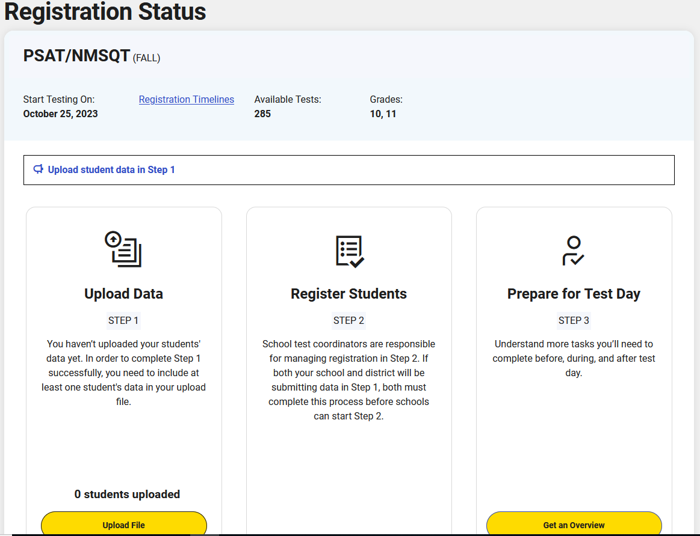

Slide 21
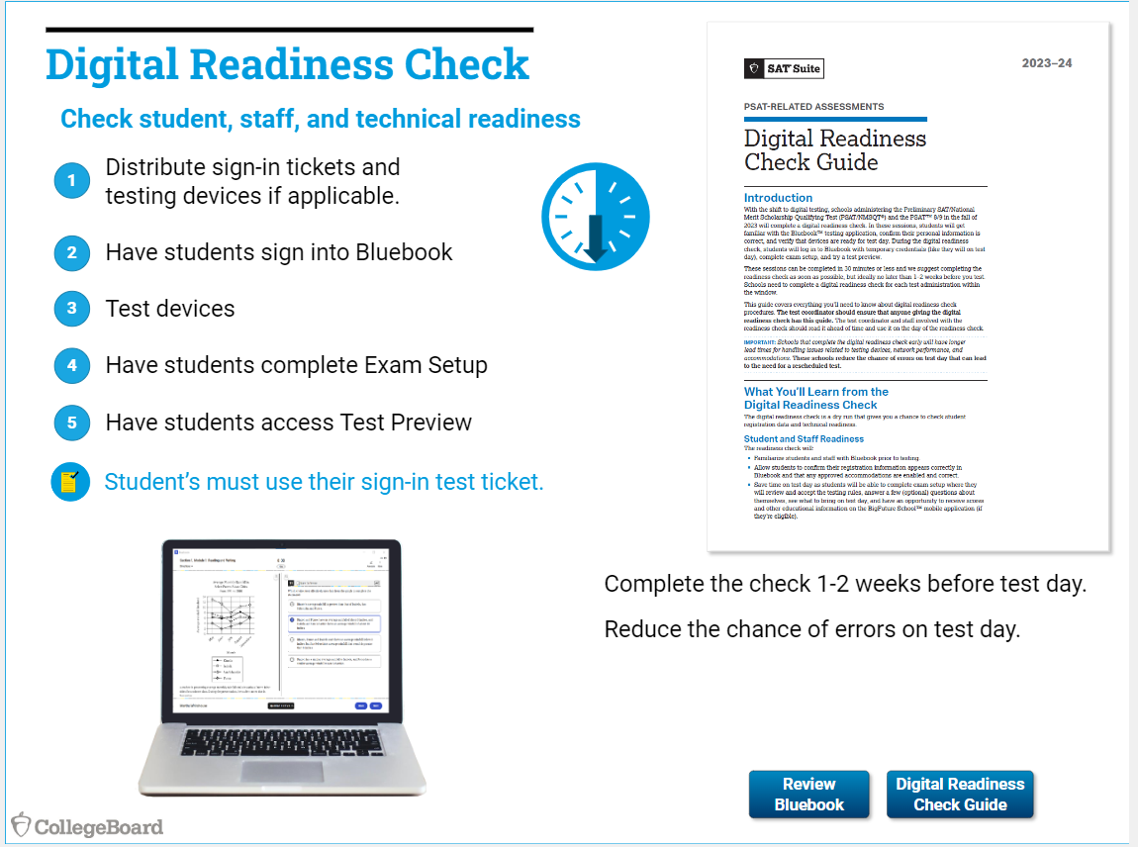
Digital Readiness Check
***Recommended***(HIGHLY)
Students are able to complete a full-length
practice test, check accommodations,
Digital Readiness Check guide posted in
Google Classroom (and copies here)
Allows you to work out any issues with staff
and student log ins to Bluebook prior to
test day

Slide 22
Preparation – Testing Rooms
Identify accommodated rooms first (extra time, small group)
Identify testing rooms that meet room and seating requirements and a help room
Cover any instructional materials that might give assistance on test items
Help Room – REQUIRED
  Manned by school tech to provide tech support during digital testing
  Located near/central to testing rooms
  Set up with tables/chairs
  Power outlet/strips

Slide 23
Preparation – Testing Rooms
Room Type | Number of Students | Proctors Needed | Room Monitors Needed
Standard time | 34 | 1 | 0
Standard time | 45 | 1 | 1
Standard time (large room) | 145 | 1 | 3
Extended time | 30 | 1 | 1

Slide 24
Room Staff Ratios
One proctor will be assigned per room. Then add one room monitor for the following scenarios:
Standard rooms with more than 34 students.
Larger rooms with more than 50 students (1 room monitor for each additional 50 students).
Extended time rooms with more than 20 students.

Slide 25
Staffing Examples
School A:
  Your school is testing 100 grade 10 standard testers.
  You have 4 classrooms available, each with capacity for 25 students.
Therefore, you'll require seven staff:
  1 test coordinator
  1 technology monitor
  4 proctors
  1 hall monitor
School B:
  Your school is testing 100 grade 10 standard testers.
  You plan to test in 1 large room (e.g., cafeteria or gym).
Therefore, you will require six staff:
  1 test coordinator
  1 technology monitor
  1 proctor
  2 room monitors
  1 hall monitor

Slide 26
Room Requirements
Strong WIFI signal strength
Free from noise and distractions
Close to restrooms
Seating - 3 feet apart measured center to center
12”x15” minimum writing surface
All chairs have backs
Staff can see all student screens
Clock and board that students an see
Power outlets/strips for extended testing
NO: round tables, study carrels, seats with lapboards, language lab booths, tables with partitions/dividers

Slide 27
Test Day Toolkit Tasks
Student Roster – Review and assign
Staff list – review/invite/assign
Room List – Add/assign
Verify accommodations
Print student tickets

Slide 28
Review your student roster
Navigate to the All Students page to view your roster.
Use the SAT Suite Ordering and Registration (SSOR) system to add students or correct their accommodations and personal information.
Students won’t be listed here until they’re registered in SSOR.

Slide 29
Create your staff list
Navigate to the Staff page.
Add contact details for your proctors and other test day staff.
If you’ve used the toolkit before, you can also select returning staff from your staff list.
College Board will send access emails to all staff and use the contact details you provide for 2-step verification. Mobile numbers make first-time access easier.
You will need to add all required staff – Proctors, Monitors, Tech

Slide 30
Add Testing Rooms
Navigate to All Rooms.
Give each room a seating capacity and a name.
If you’re testing in the same room multiple times, you must add a room in Test Day Toolkit for each session to create unique student rosters.
Use this naming convention for rooms you’re reusing: Add the month and day after the room name. If necessary, add the time, too. Use letters and numbers only. For example, create rooms called “Cafeteria Oct 6 AM” and “Cafeteria Oct 6 PM” if you’re using the cafeteria to test one group in the morning and another group in the afternoon.

Slide 31
Add a “Late Testing Room”
If possible, reserve a room for students who arrive at their assigned room after the proctor reads the script.
Note: If you preassign students to rooms in Test Day Toolkit, you or your staff will need to reassign late students before they enter a room code.

Slide 32
Assign Students to Rooms
On the All Students page, filter or sort your roster by testing group.
Select multiple students and use the Action drop-down menu to move them to rooms in bulk.
The Test Coordinator Test Day Guide and the Accommodations Guide have more information about testing groups and room assignments.
If you skip this step, the toolkit creates room rosters on test day when students enter the room code their proctor gives them.

Slide 33
Check Small-Group Testing
Look in the Accommodations column on your roster for students approved for small-group testing.
If any student approved for small-group testing is assigned to a room with more than 15 seats, move them to a smaller room.
Move each student approved for one-to-one testing to their own room.

Slide 34
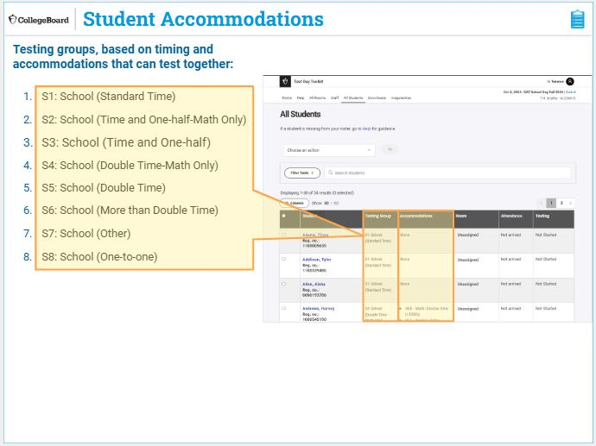
Student Accommodations

Slide 35
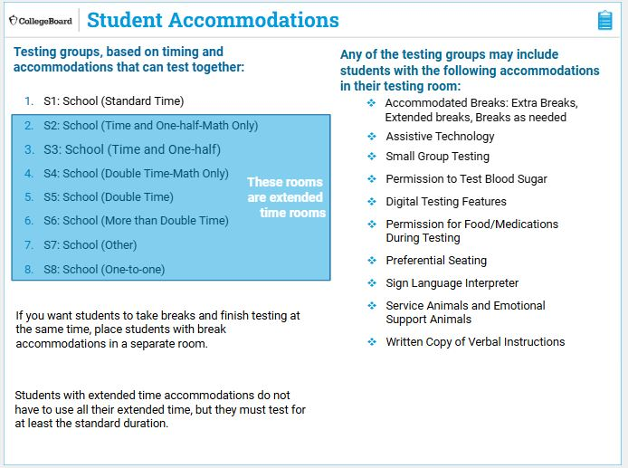
Student Accommodations

Slide 36
Assign Staff
Assign each proctor to a room.
Proctors can be assigned to only 1 room at a time. If someone is proctoring multiple times during the testing window, assign them to a new room after each session.
Assign room monitors as needed to meet required staffing ratios.
Assign 1 or more technology monitors by selecting Technology coordinator.
Don’t assign technology monitors to a room.

Slide 37
Print Student Tickets
Click Print Sign-In Tickets on the Test Day Toolkit homepage.
Choose a printing option.
You can print a PDF with all tickets sorted alphabetically.
You can also print a PDF with tickets sorted by room if you assigned students to room.
The PDF prints 4 tickets per page.
Select single-sided printing.

Slide 38
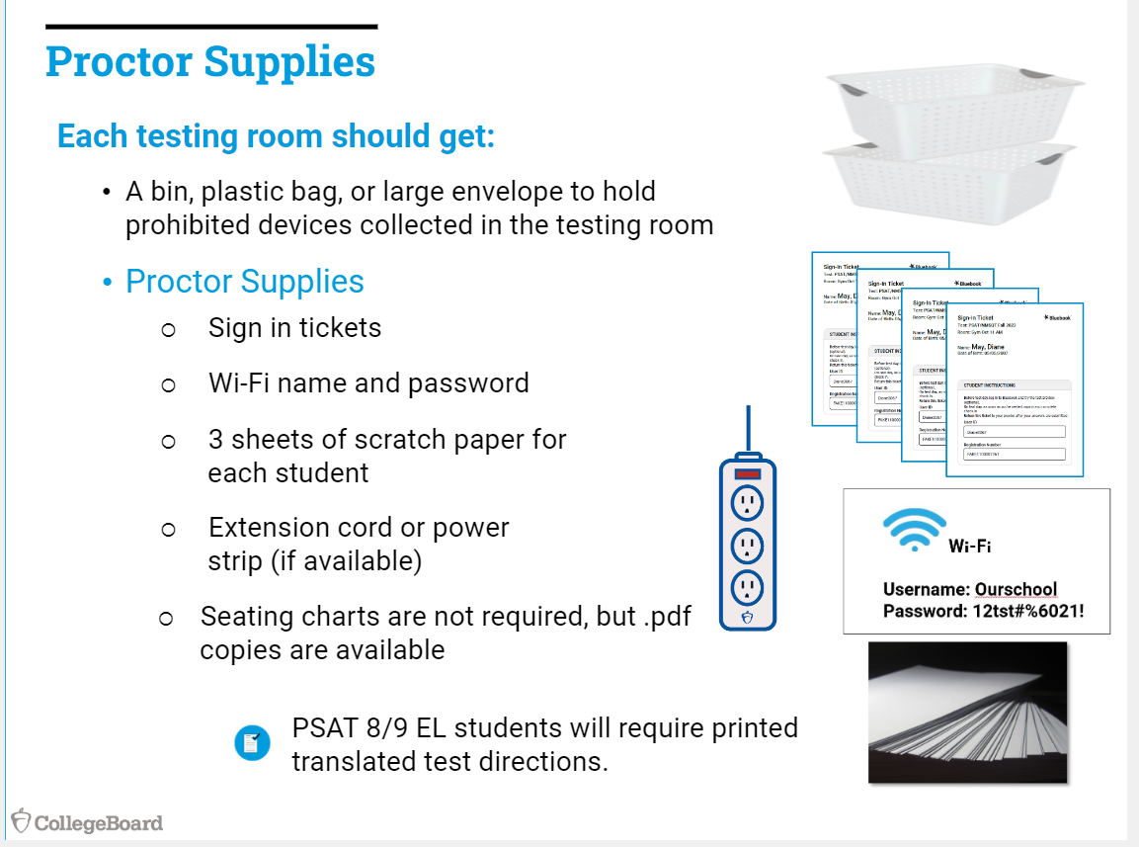
and

Slide 39
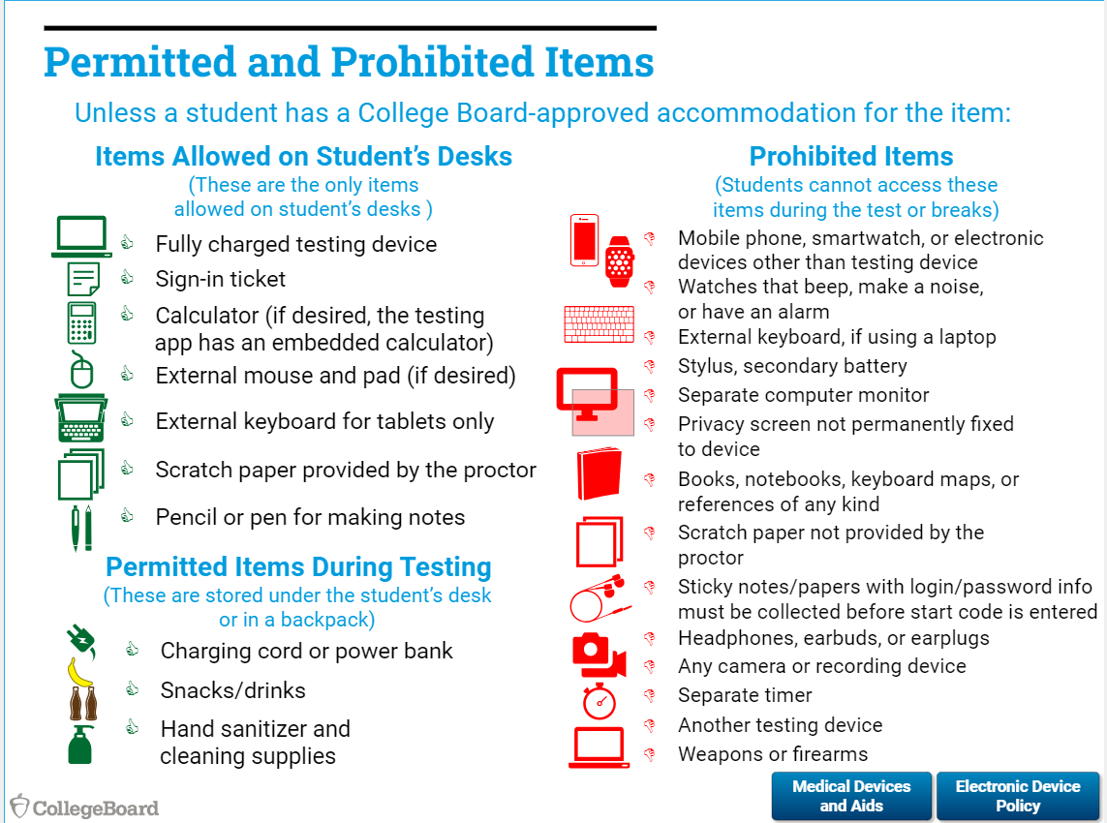

Slide 40
Test Day Procedures
Grant full access to staff in Test Day Toolkit – day before
Meeting with testing staff to cover
  Review schedule and breaks
  Review staff assignments
  Emphasize test security
  Describe signaling plan (for technical issues)
  Distribute supplies to Proctors
  Late room, if applicable

Slide 41
Test Day Procedures
Proctors complete room checklist in TDTK – write the generated room code on the board
Students will sign into Bluebook with the yellow icon “Use a sign in ticket from your school” – they should not use their College Board account log in, even if they have one
  Student will click on the “Check in Now” button listed under the PSAT/NMSQT Fall 2025 test on their dashboard
  Students will confirm their personal information and any test accommodations
  Students enter the posted room code
Proctor will take attendance in TDTK – checking ID if needed
Students cannot continue until they have been marked “Present” by the proctor
Students will have to type the Digital Test Security pledge
Once all students are in the “Ready to Test” column, Proctor will read the script and issue the start code

Slide 42
Test Day Procedures
10 minute break between section
  Bluebook keeps each student’s testing time, so breaks will happen at different times
  Students MAY NOT use their testing device for any activities during the break
  Students leave their testing device on and must not close laptop or Chromebook covers
Unscheduled breaks are allowed
  Testing time does not stop for unscheduled breaks, students will not get extra time
  Students will select an unscheduled break in Bluebook by clicking “More” at the top right corner and then “Unscheduled Break”
Report any irregularities in Test Day Toolkit
  If a student is removed from a room, they must be removed from the test room in TDTK

Slide 43
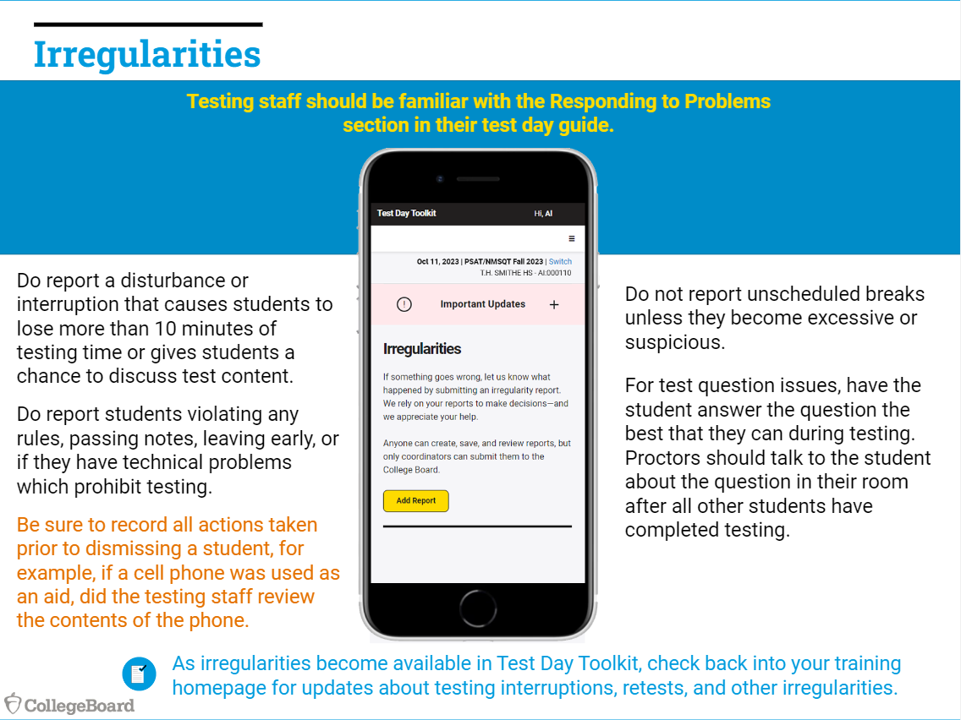

Slide 44
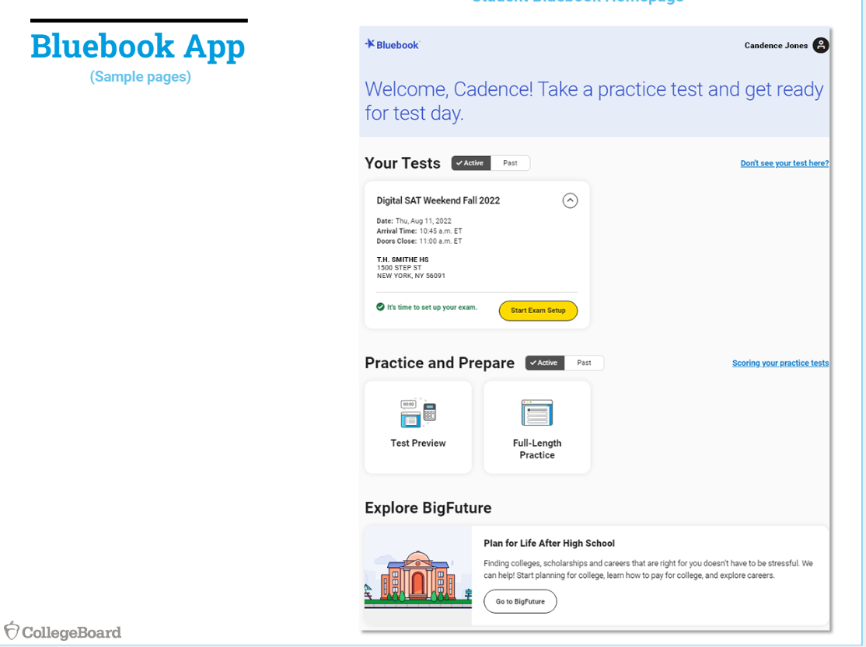
Student Dashboard

Slide 45
Student Bluebook Dashboard
Students are able to look at a test preview or take a full length practice test from within Bluebook.
They can also access BigFuture, College Board’s college and career planning tool.

Slide 46
Submitting Answers
If students don’t have an internet connection when they run out of testing time, their answers can’t be submitted automatically.
Proctors and technology monitors can solve most submission issues using the troubleshooting tips in their guides.
Students need to submit their answers using the same device they tested on.
Students who test on a shared device should keep that device until they successfully submit their answers.
For PSAT-related assessments, answers must be submitted within 24 hours.
Students will need to sign in to Bluebook again when they have an internet connection and click Submit Answers on their Bluebook homepage.
For PSAT-related assessments, students sign in with the credentials on their sign-in ticket.

Slide 47
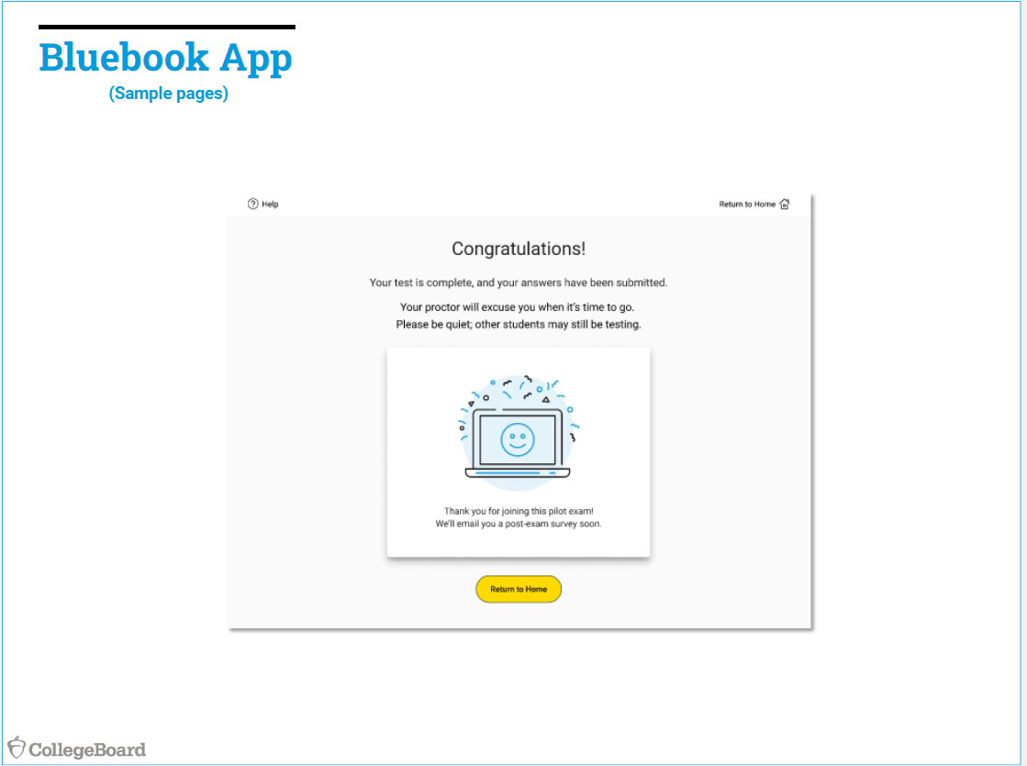
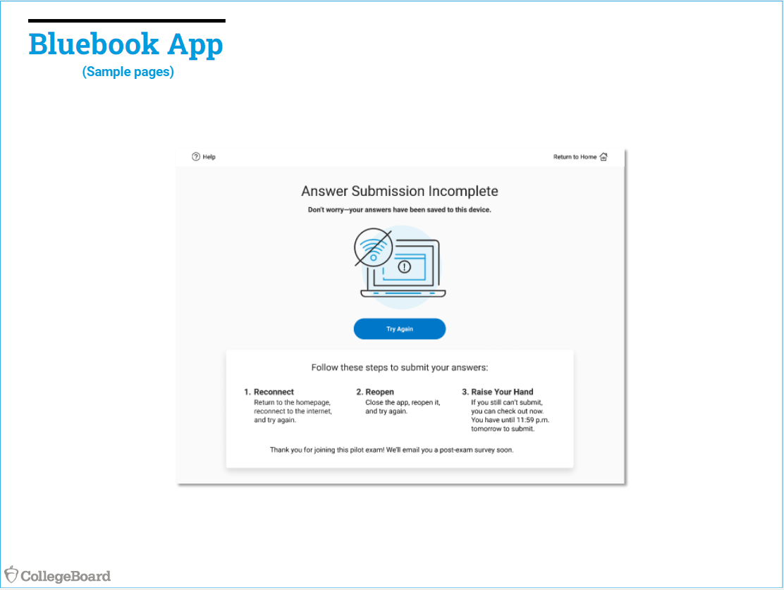
Complete vs. Incomplete

Slide 48
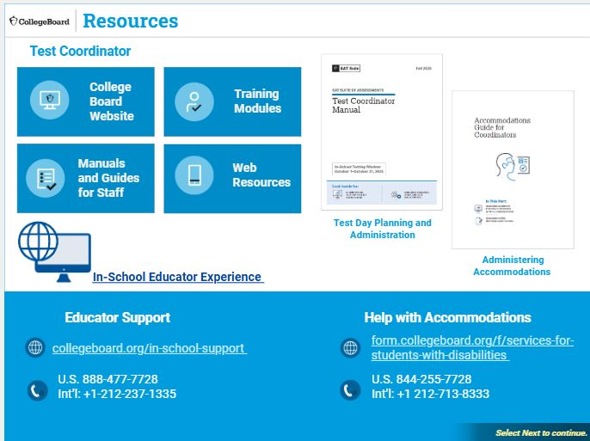

Slide 49
Resources
Test Coordinator Manual: Test Test Coordinator
SSD Coordinator: SSD
Proctor (test administrator): Proctor
Hall and Room Monitor: Hall/Room Monitor
Technology Monitor: Tech Troubleshooting

Slide 50
Questions
Heather Rykard
  Accommodations, Test Administration
  hrykard@ecsdfl.us
  850-469-5387
Scott Dodson
  Data uploads, Score uploads
  sdodson@ecsdfl.us
  850-469-5389

